Slide 1
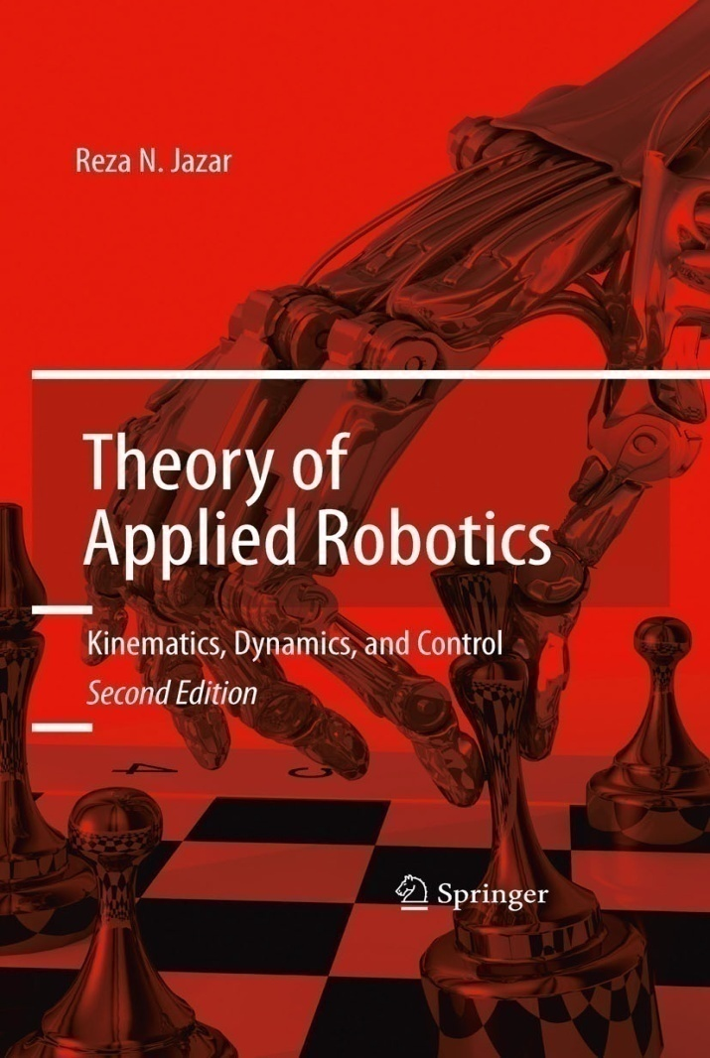
California State University, San Bernardino
School of Computer Science and Engineering
CSE 5410 Robotics and Control
Instructor :
Haiyan Qiao

Slide 2
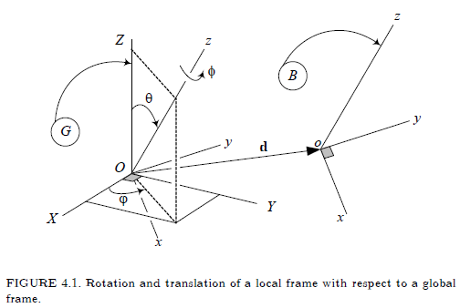
Chapter 4. Motion Kinematics
A rotation ϕ about an axis z and a displacement d is the general
motion of a rigid body B in a global frame G. The rigid body motion
can be defined by a 4 by 4 matrix.

Slide 3


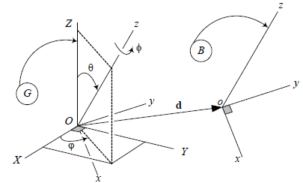
4.1. Rigid Body Motion
If the vector ^{G}d indicates the position of the moving origin o, relative to the fixed origin O, then the coordinates of a body P in local and global frames are related by the following equation:
The vector ^{G}d is called the displacement or translation of B with
Respect to G, and ^{G}R_{B} is the rotation matrix to map ^{B}r to ^{G}r when
^{G}d = 0.

Slide 4
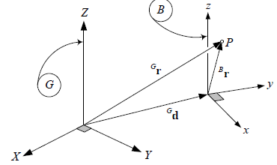
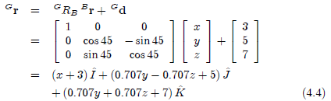
Example 71 translation and rotation of a body coordinate frame.
A body coordinate frame B(oxyz), that is originally coincident with global coordinate frame G(OXYZ), rotates 45 deg about the X-axis and translates to [3 5 7]^{T}

Slide 5
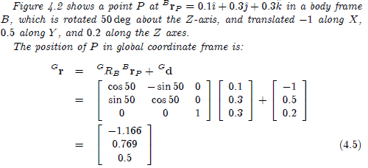
Example 72 Moving body coordinate frame.

Slide 6
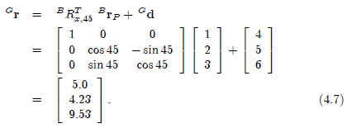
Example 73 Rotation of a translated body.
Point P of a rigid body B has an initial position vector ^{B}r_{P}.
^{B}r_{P} = [1 2 3]^{T}
If the body rotates 45 deg about the x-axis, and then translates to ^{G}d = [4 5 6]T, the final position of P would be.
Note that rotation occurs with the assumption that ^{G}d = 0.

Slide 7
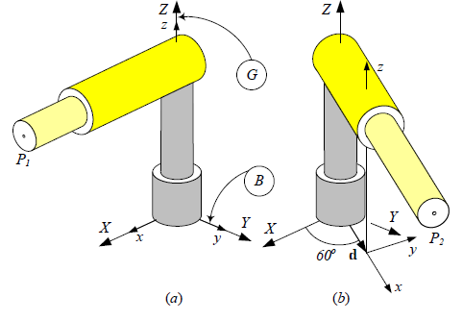

Example 74 Arm rotation plus elongation.
Position vector of point P1 is at mm. The arm rotates 60 deg about the global Z-axis, and elongates by d = 720.2 i mm. The new position vector of P is

Slide 8
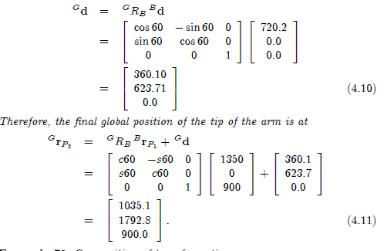

Slide 9
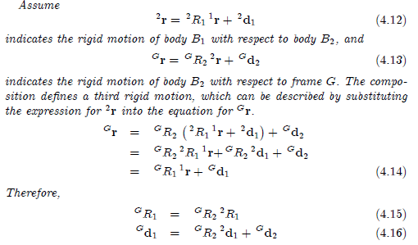
Example 75 Composition of transformations.

Slide 10
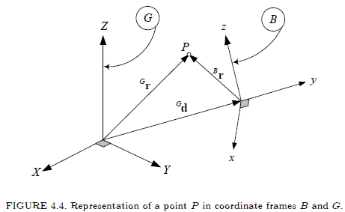
4.2. Homogeneous Transformation
The vector ^{G}d indicates the position of origin o of the body frame in the global frame.

Slide 11
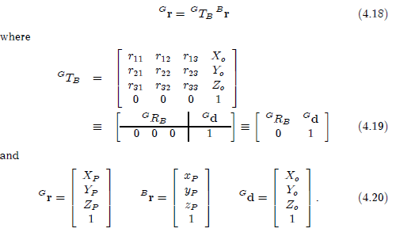
Introducing a new 4X4 homogeneous transformation matrix
^{G}T_{B}, helps us show a rigid motion by a single matrix transformation.

Slide 12


Representation of an n-component position vector by an (n+1)
component vector is called homogeneous coordinate representation.
The appended element is a scale factor, w, hence, in general,
homogeneous representation of a vector r =[x y z]^{T} is
It is the three ratios, r1/w, r2/w, and r3/w that are important because
Provided w ≠ 0, and w ≠ ∞.

Slide 13
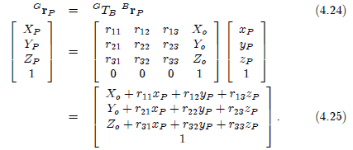
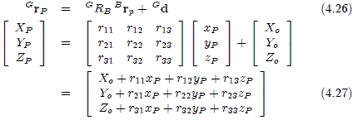
Proof.
If we use the standard method,

Slide 14
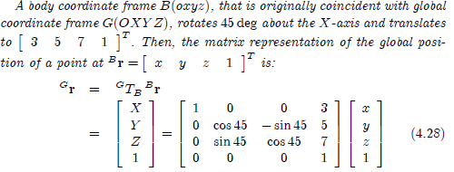
Example 76 Rotation and translation of a body coordinate frame.

Slide 15


Example 80 Homogenous transformation for rotation about global axes. The rotation α about the Z-axis is
Example 81 Rotation about and translation along a global axis.
A point P is located at (0 0 200) in a body coordinate frame. If
the rigid body rotates 30deg about the global X-axis and the origin of
the body frame translates to (X, Y, Z) = (500, 0, 600), then the
Coordinates of the point in the global frame are:

Slide 16

Example 82 Rotation about and translation along a local axis.
A point P is located at (0 0 200) in a body coordinate frame. If
the origin of the body frame translates to (X, Y, Z) = (500, 0, 600) and
rotates 30deg about the local x-axis and then the coordinates of the
point in the global frame are:

Slide 17

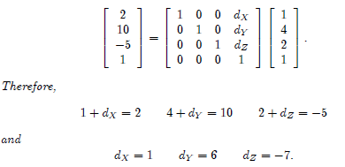
Example 83 Translation.

Slide 18
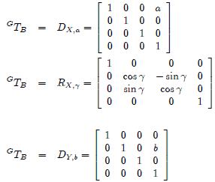
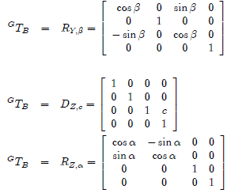
Example 84 Pure rotation and pure translation.

Slide 19

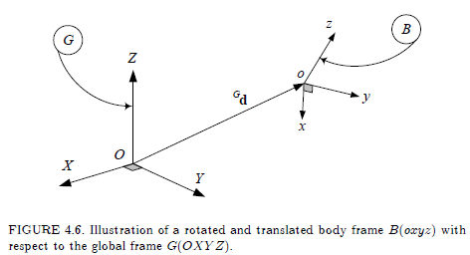
4.3. Inverse Homogeneous Transformation
The advantage of simplicity to work with homogeneous transformation matrices come with the penalty of losing the orthogonality property.

Slide 20
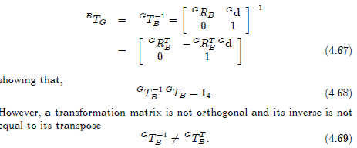
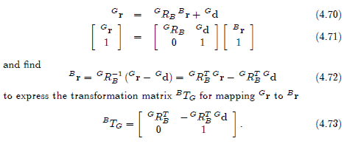
Proof. 1

Slide 21
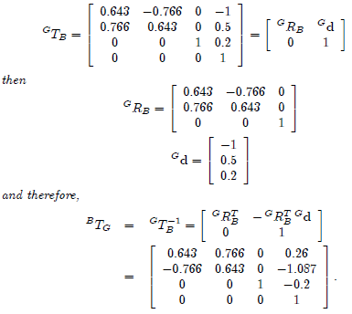
Example 88 Inverse of a homogeneous transformation matrix.

Slide 22
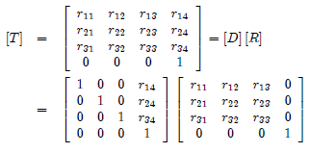
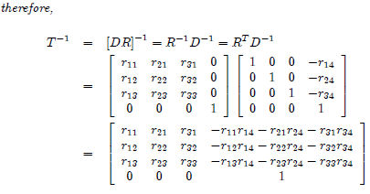
Example 90 Quick inverse transformation.

Slide 23
Example 90 Quick inverse transformation.

Slide 24
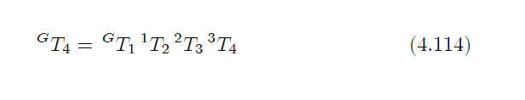
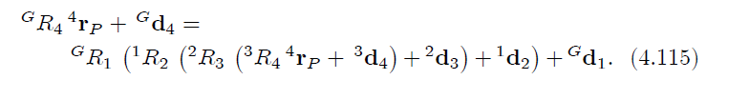
4.4. Compound Homogeneous Transformation
The value of homogeneous coordinates are better appreciated when several displacements occur in succession which, for instance, can be written as
Rather than

